Slide 1
ARACHNE
PROJECT
Risk scoring tool
March 2014

Slide 2
Agenda
What is Arachne ?
  Goal
  Objectives
  Benefits
Overview of Risk Categories and Risk Indicators
Screen shots Arachne application

Slide 3
Project ARACHNE aims at providing
the MS authorities involved
in management of the Structural Funds
with an operational tool
to identify their most risky projects.

Slide 4
Objectives
Support the Management and Control Systems of the OPs, to lower the error rate and strengthen
fraud prevention and detection
Facilitate the continuous monitoring / overview of the internal and external data regarding projects, beneficiaries and contracts/contractors

Slide 5
How ?
-> Based on a set of risk indicators and alerts
-> Customized to the nature of OP expenditures
-> Using some key (internal) data of the projects
enriched with publicly available information
(external data)

Slide 6
Benefits
In view of limited resources and multiplicity of operations,
key actors and systems,
Promote the use of a risk based approach in the verifications of the projects (focus on most risky projects)
Complement the risk assessment with regard to fraud alerts and irregularities
Identify possible irregular circumstances continuously on the basis of predefined risk criteria
Build an overall better defense against fraud and errors

Slide 7
Risk indicators and alerts
Risk category | Description
Procurement | Risk indicators on the procurement process
Contract management | Assessment of contract management aspects of the project and comparison to the peer group
Eligibility | Verification of the eligibility period and existence of contractors and subcontractors
Performance | Assessment of the coherence of activity sector ratios with the benchmark values
Concentration | Cross-project and cross-operational program checks
Other | Basic checks on logicality and reasonability of project data
Reputational and fraud alerts
 | Financial: Overall financial performance of beneficiaries, contractors / suppliers and sub-contractors, based on financial reporting data
 | Relationship: Existence of relationships between beneficiaries and contractors / suppliers or sub-contractors and their respective personnel
 | Reputation: Involvement in activities (such as bankruptcies) that could possibly result in reputational damages
 | Sanction: Identification of beneficiaries, contractors/suppliers, subcontractors or their respective personnel, blacklisted of appearing in any type of sanction list
 | Change: Any type of changes to the company structure

Slide 8
Examples of risk indicators and alerts
Procurement
Lead time between publication of the tender notice and contract signature
Number of disqualified tender offers / Number of tender offers received
Contract management
Contract addenda cost (total) for the project / Project cost
Number of consortium partners
Eligibility
Project costs outside eligibility period - before start date
Project costs outside eligibility period - after end date
Performance
Number of people trained / Number of people to be trained
Project total cost / Length in km per Project (Per Type of Road)

Slide 9
Examples of risk indicators and alerts
Concentration
Beneficiaries involved in multiple Projects
Project partners involved in multiple Projects
Consortium members linked to multiple Projects
Sub-contractors linked to multiple Projects
Other checks
EC assistance / Total Project cost
Fixed assets / Project cost

Slide 10
Examples of risk indicators and alerts
Reputation and Fraud alerts
  Financial
  High or deteriorating propensity to bankruptcy
  Relationship
  Links between beneficiaries/project partners and contractors/suppliers
  Reputation
  Involvement of directors / shareholders with bankruptcies
  Involvement of directors / shareholders from sensitive regions
  Sanction alerts
  Involvement of individuals included in PEP list
  Involvement of individuals / entities included in sanction lists
  Change alerts:
  High rotation of directors
  Activity changes

Slide 11
Main functionalities of Arachne
Internal data upload from Member States
External data enrichment (Orbis, WorldCompliance )
Risk score calculation based on internal and external data
Output visualisation in dashboards
    High risk beneficiaries / projects / contractors / contracts
    Drill-down functionalities
    Visualisation of links between entities/individuals
    Scenario analysis
Export options
Case management
Feedback loop
User management

Slide 12
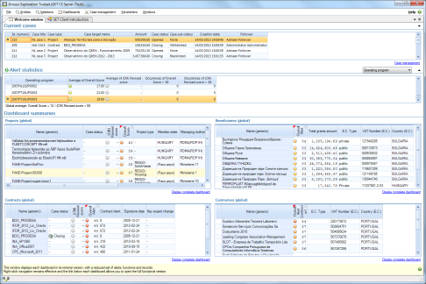
Data Flow
Member States
DIGIT
GET Application Server
Operational Data
Operational Data
GET database
SFC2007
Vadis
European Commission
Member States
Operational Data
GET database
Orbis
World Compliance

Slide 13

Orbis
  Orbis has information on :
    Companies : +/- 100 million companies worldwide
      Financial data of the company (turnover, shareholders, …)
      Address information
      Related people (directors, contact people, …)
      Indicators like credibility and bankruptcy
    Persons : +/- 100 million persons
      First name, last name, Age
      Number of affinities, number of companies and role in company
  The data is collected from publicly available information such as official annual reports or balance sheets submitted to regulatory bodies
  The level of details available in the database varies by country and company size
  All data available in Arachne

Slide 14

World Compliance
  World Compliance collects, aggregates and centralizes :
    PEP lists (politically exposed person)
    Sanctions lists (EU Terrorism List, ICE List, CBI List, …)
    Enforcement list (narcotic & human traffickers, money launderers, fraudsters and other criminals, …)
    Adverse media list (company or person that have been linked to illicit activities by news sources)
  The data is received from regulatory and governmental authorities (except for adverse media list)
  Information is only accessible through the Arachne alert details (It won’t be possible for a user to explicitly retrieve these information for a given company/person)

Slide 15
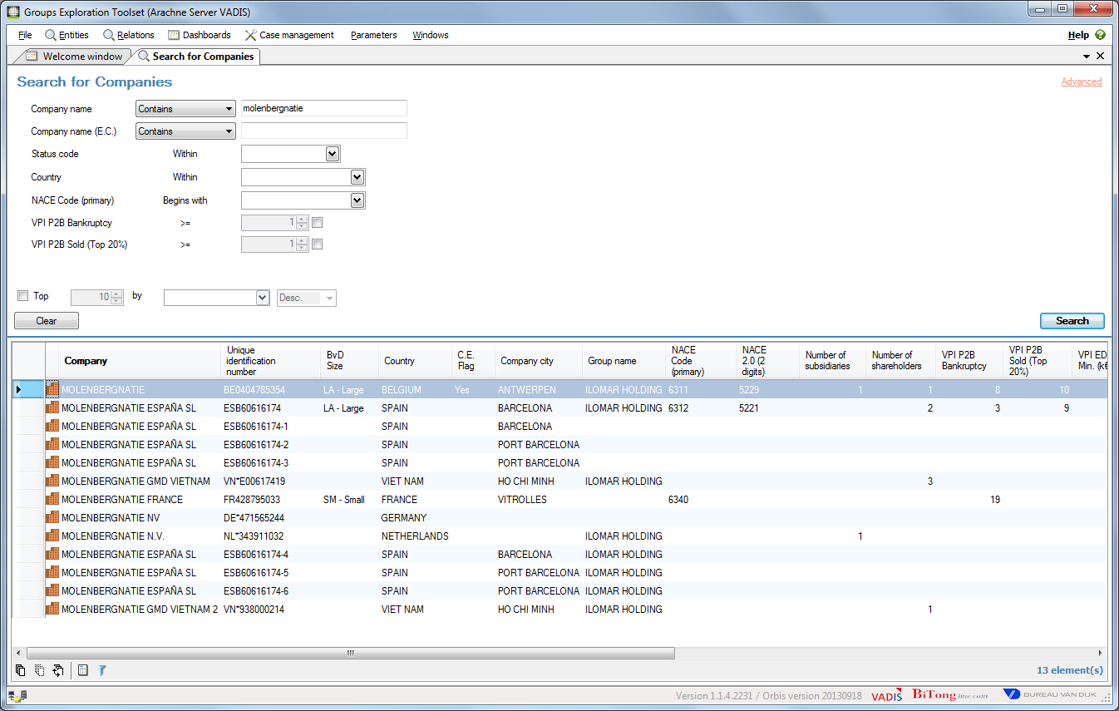
Company / persons

Slide 16
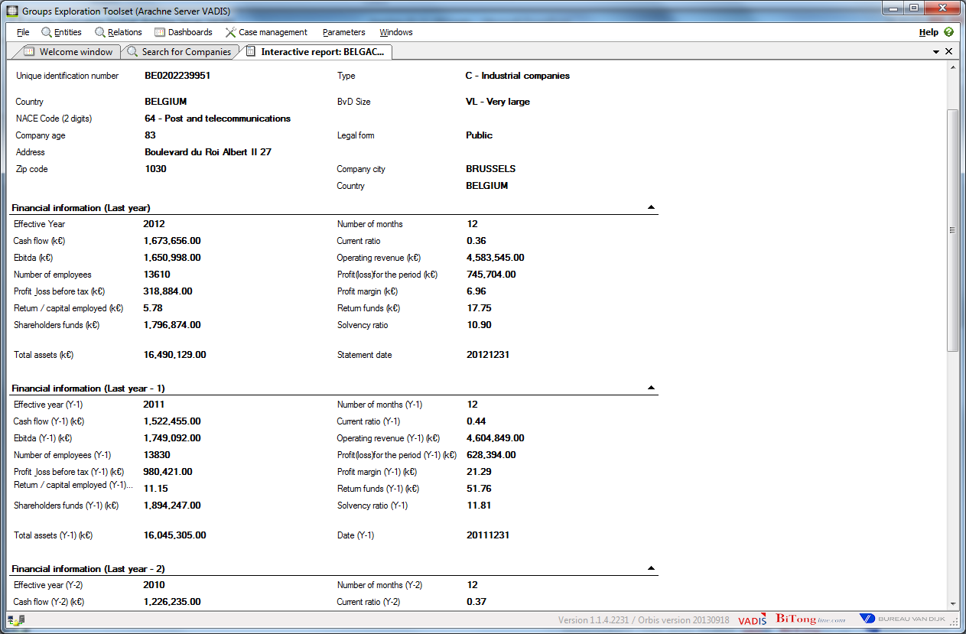
Interactive report

Slide 17
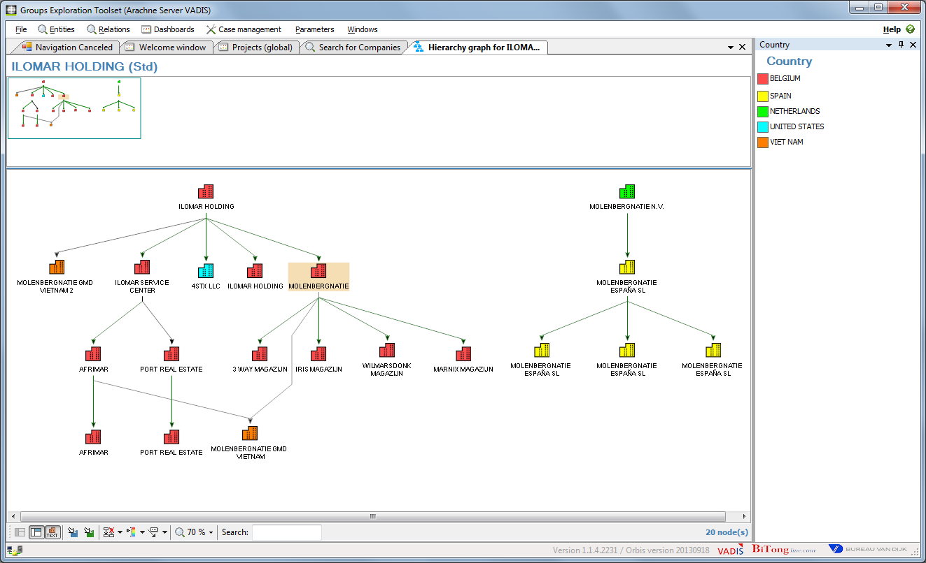
Company hierarchy

Slide 18
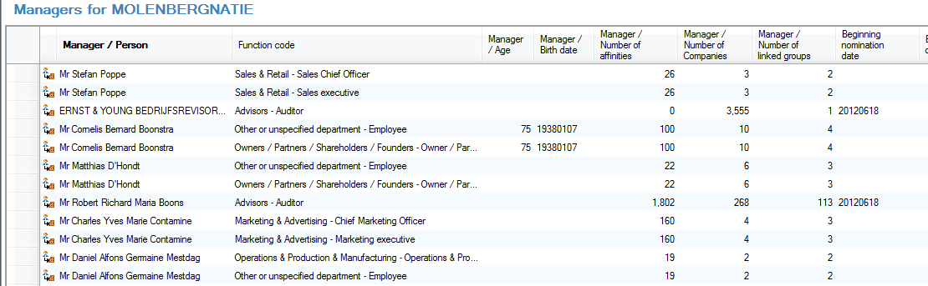
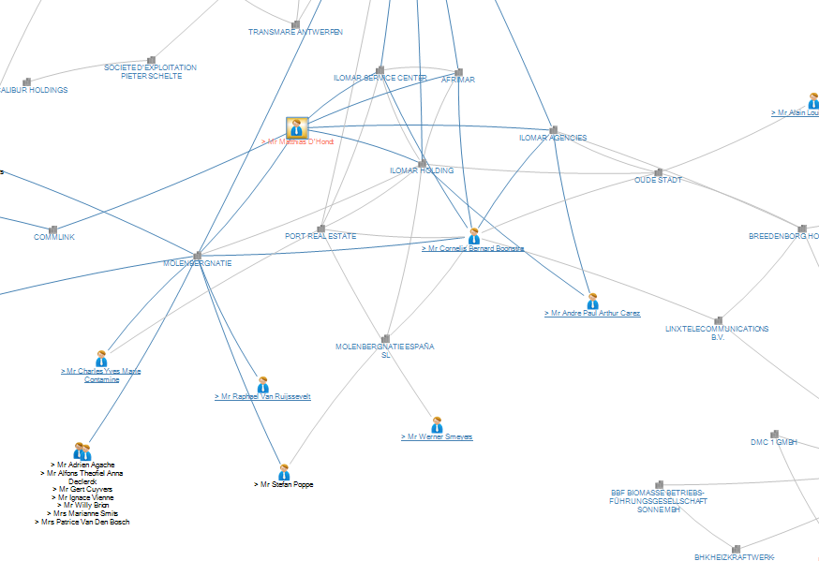
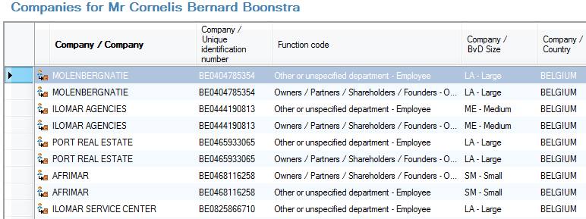
Lists and Graphs

Slide 19
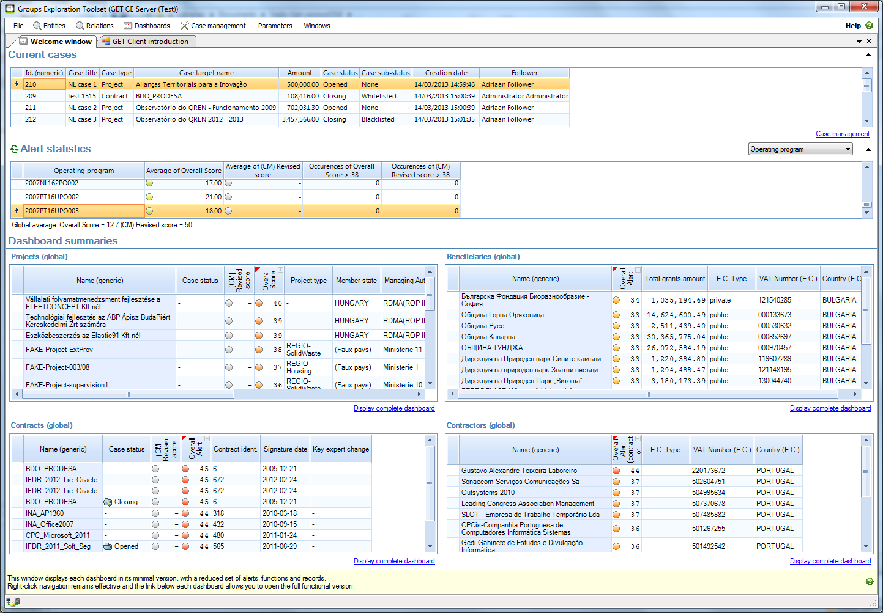
Welcome window

Slide 20
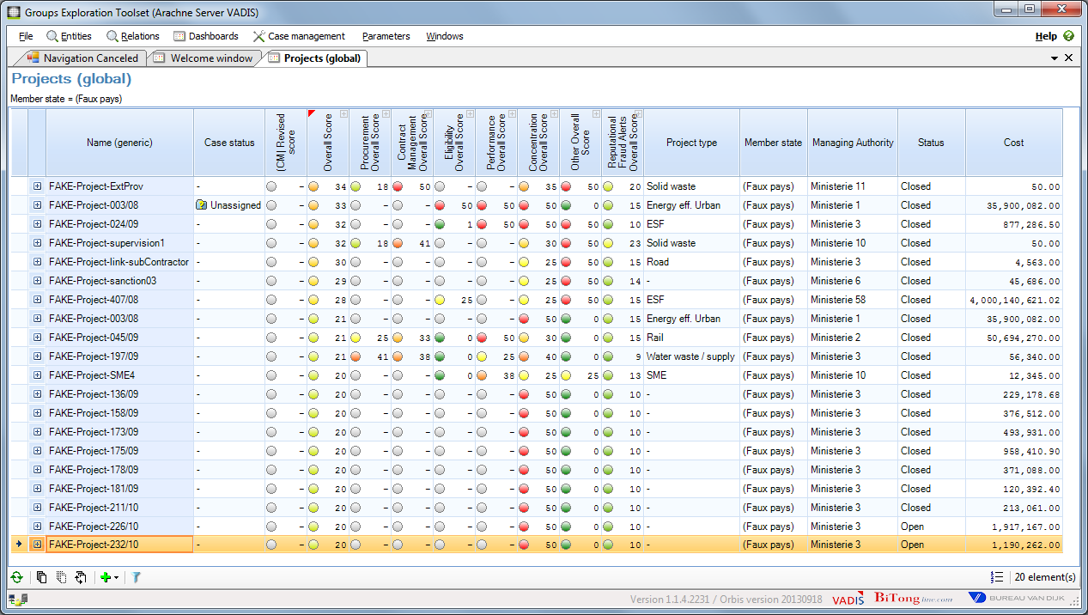
Project dashboard

Slide 21
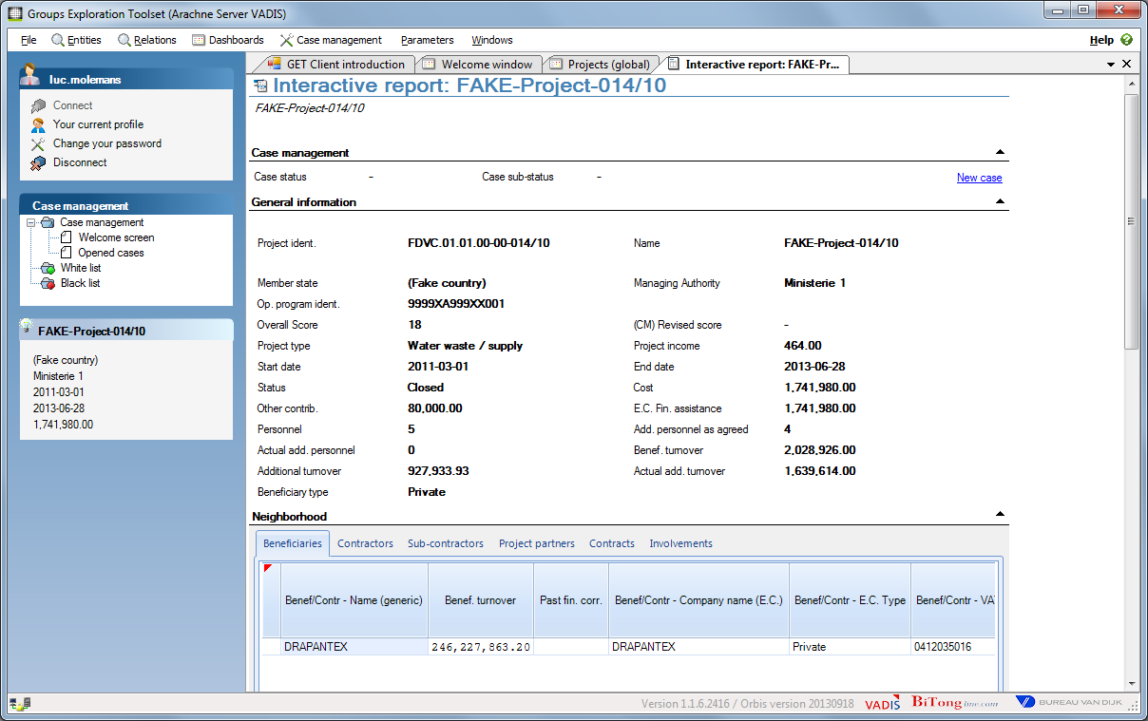
Project details

Slide 22
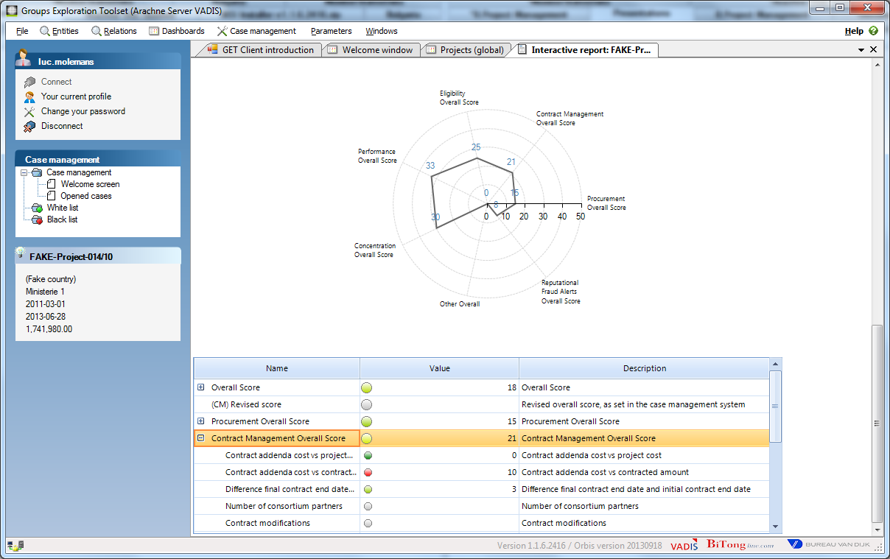
Project details

Slide 23
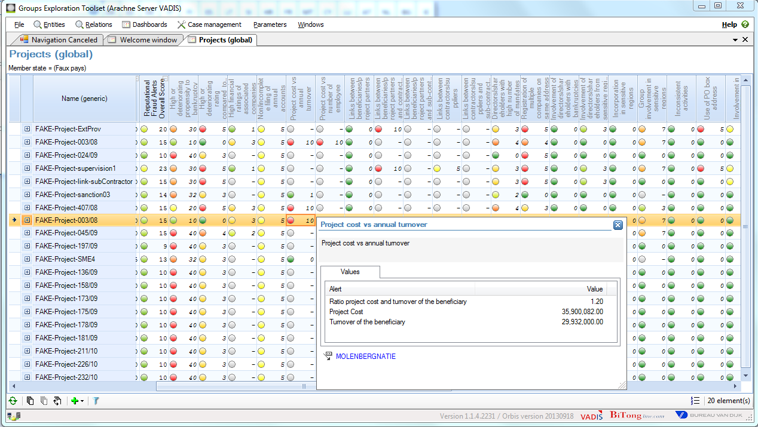
Detail risk indicator

Slide 24
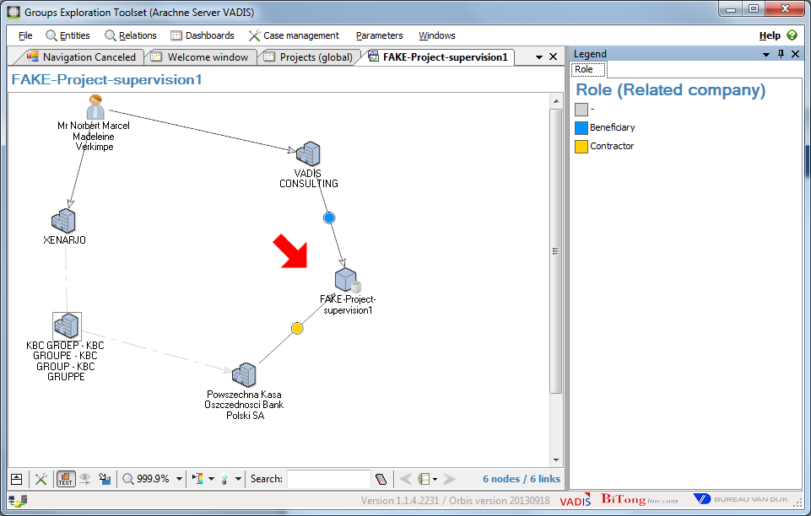
Detail risk indicator

Slide 25
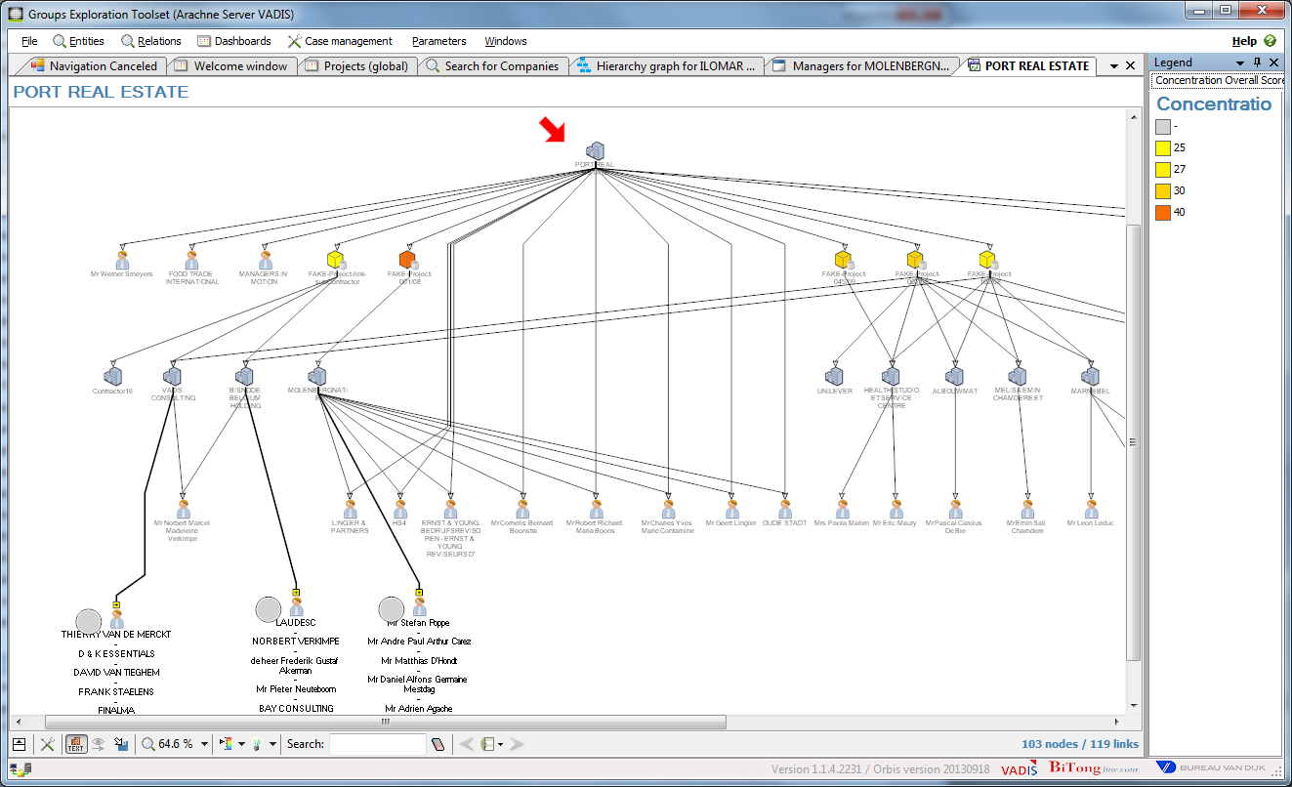
Surrounding graph

Slide 26
Thank you for your attention
Questions?

